Slide 1
ScienceQTech Employee
Performance Mapping
ScienceQtech is a startup that works in the Data Science field. ScienceQtech has worked on fraud detection, market basket, self-driving cars, supply chain, algorithmic early detection of lung cancer, customer sentiment, and the drug discovery field. With the annual appraisal cycle around the corner, the HR department has asked you (Junior Database Administrator) to generate reports on employee details, their performance, and on the project that the employees have undertaken, to analyze the employee database and extract specific data based on different requirements.

Slide 2
ScienceQTech Employee
Performance Mapping
Objective:
To facilitate a better understanding, managers have provided ratings for each employee which will help the HR department to finalize the employee performance mapping. As a DBA, you should find the maximum salary of the employees and ensure that all jobs are meeting the organization's profile standard. You also need to calculate bonuses to find extra cost for expenses. This will raise the overall performance of the organization by ensuring that all required employees receive training.

Slide 3
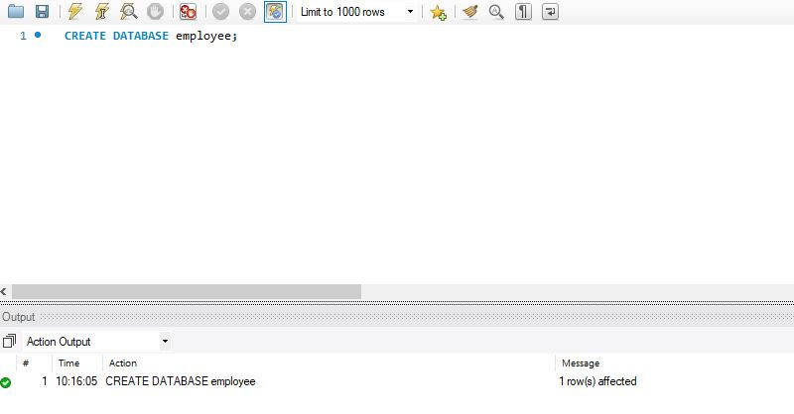
Database
Task 1. Create a database named employee, then import data_science_team.csv proj_table.csv and emp_record_table.csv into the employee database from the given resources

Slide 4
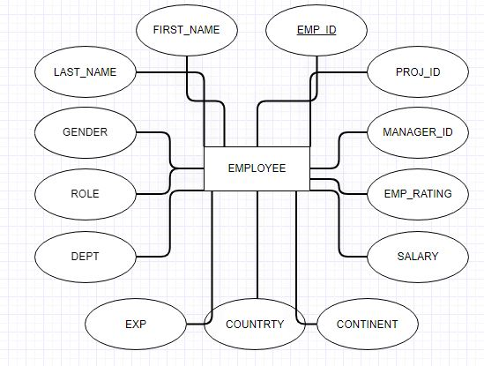
ER Diagram
Task 2. Create an ER diagram for the given employee database

Slide 5
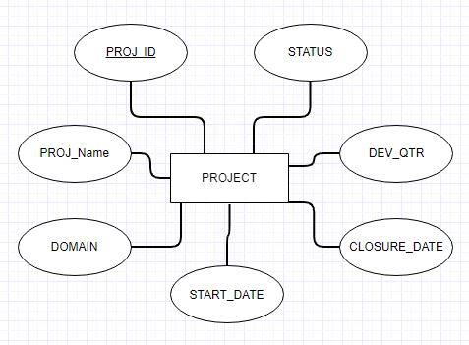
ER Diagram
Task 2. Create an ER diagram for the given employee database

Slide 6
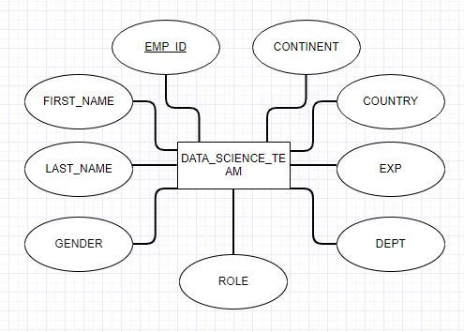
ER Diagram
Task 2. Create an ER diagram for the given employee database

Slide 7
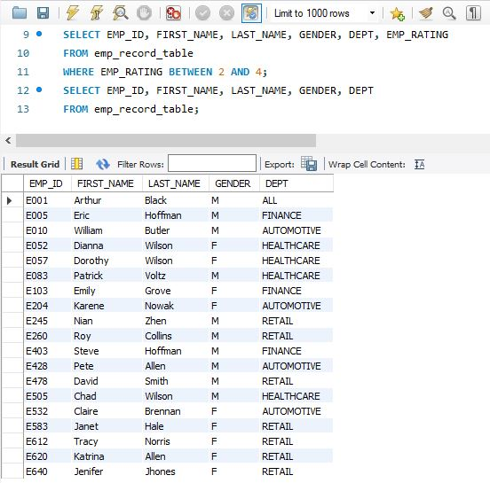
SELECT Statement
Task 3. Write a query to fetch EMP_ID, FIRST_NAME, LAST_NAME, GENDER, and DEPARTMENT from the employee record table.

Slide 8
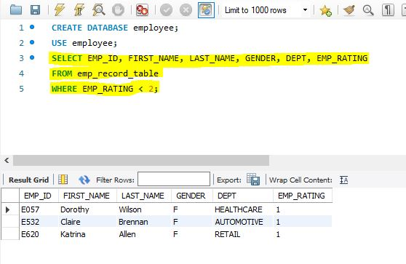
WHERE Clause
Task 4: Write a query to fetch EMP_ID, FIRST_NAME, LAST_NAME, GENDER, DEPARTMENT, and EMP_RATING if the EMP_RATING is less than two

Slide 9
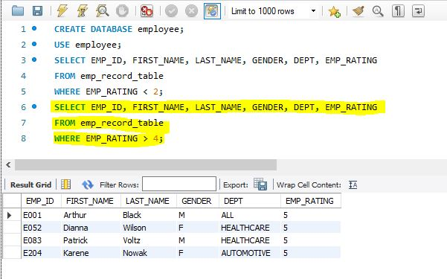
WHERE Clause
Task 4: Write a query to fetch EMP_ID, FIRST_NAME, LAST_NAME, GENDER, DEPARTMENT, and EMP_RATING if the EMP_RATING is greater than four

Slide 10
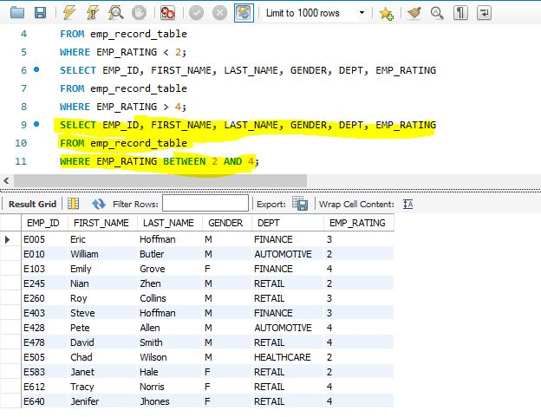
WHERE Clause
Task 4: Write a query to fetch EMP_ID, FIRST_NAME, LAST_NAME, GENDER, DEPARTMENT, and EMP_RATING if the EMP_RATING is between two and four

Slide 11
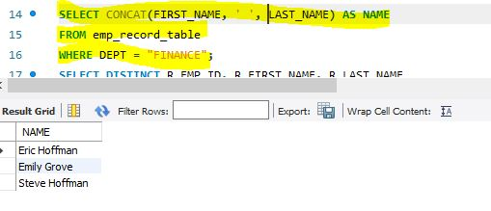
CONCAT()
Task 5: Write a query to concatenate the FIRST_NAME and the LAST_NAME of employees in the Finance department from the employee table and then give the resultant column alias as NAME

Slide 12
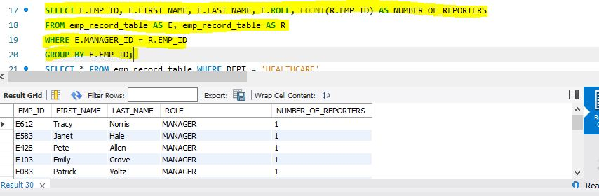
COUNT, SELF JOIN and GROUP BY
Task 6: Write a query to list only those employees who have someone reporting to them. Also, show the number of reporters (including the President)

Slide 13
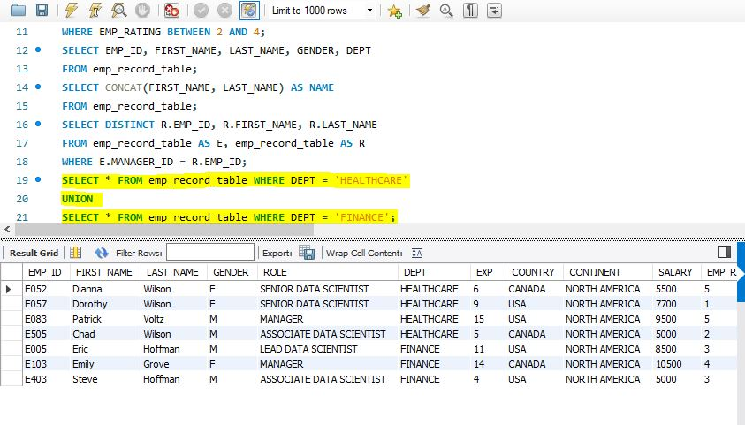
UNION
Task 7: Write a query to list down all the employees from the healthcare and finance departments using union. Take data from the employee record table

Slide 14
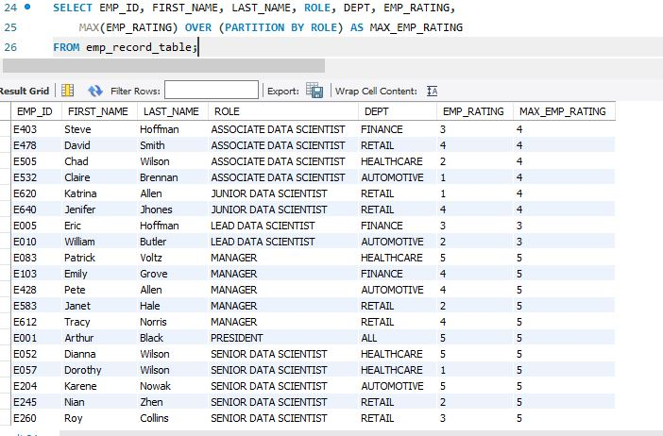
PARTITION
Task 8: Write a query to list down employee details grouped by dept. Also include the respective employee rating along with the max emp rating for the department

Slide 15
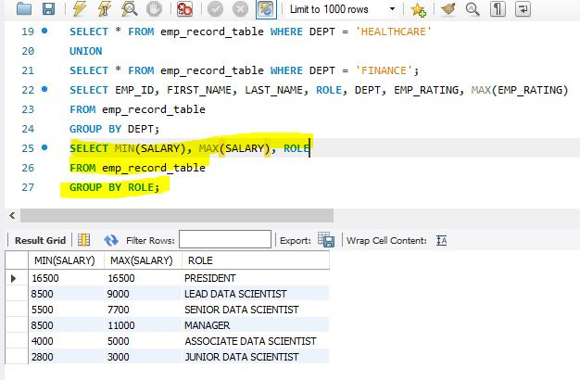
MIN() & MAX()
Task 9: Write a query to calculate the minimum and the maximum salary of the employees in each role. Take data from the employee record table

Slide 16
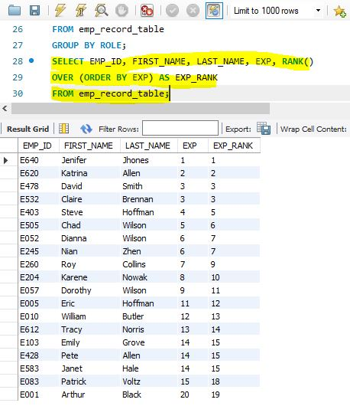
RANK()
Task 10: Write a query to assign ranks to each employee based on their experience. Take data from the employee record table

Slide 17
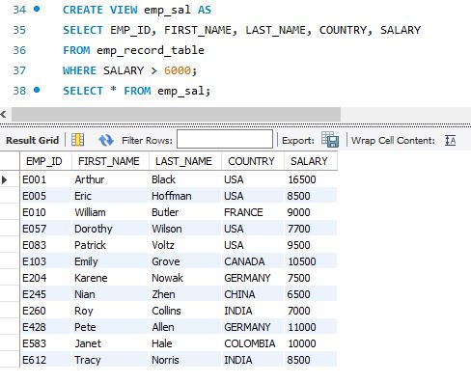
CREATE VIEW
Task 11: Write a query to create a view that displays employees in various countries whose salary is more than six thousand. Take data from the employee record table

Slide 18
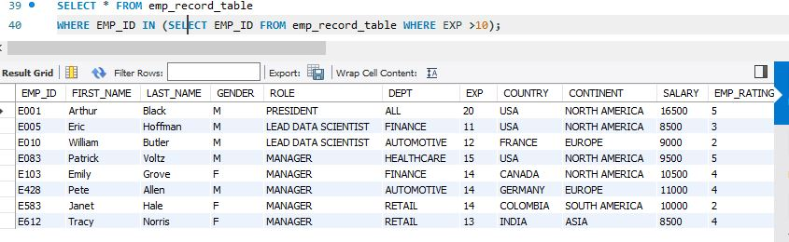
NESTED SELECT
Task 12: Write a nested query to find employees with experience of more than ten years. Take data from the employee record table

Slide 19
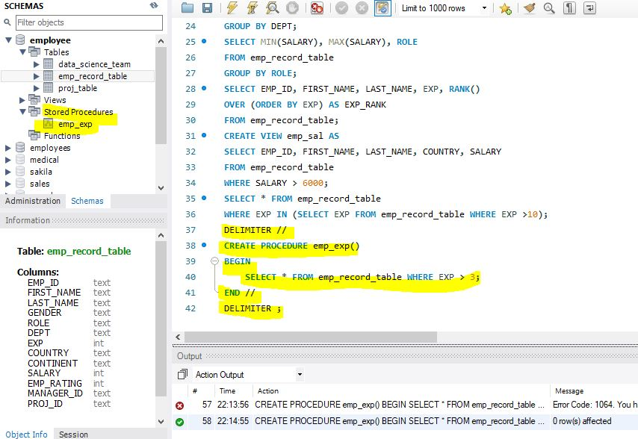
STORED PROCEDURE
Task 13: Write a query to create a stored procedure to retrieve the details of the employees whose experience is more than three years. Take data from the employee record table

Slide 20
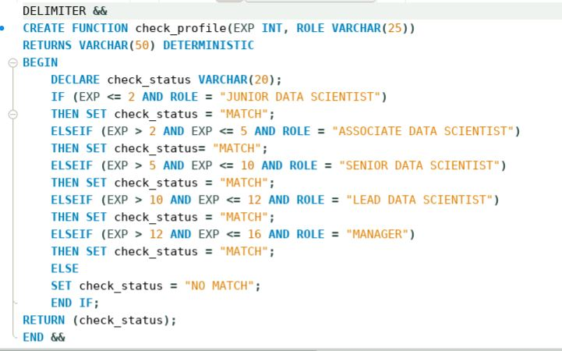
STORED FUNCTION
Task 14: Write a query using stored functions in the project table to check whether the job profile assigned to each employee in the data science team matches the organization’s set standard

Slide 21
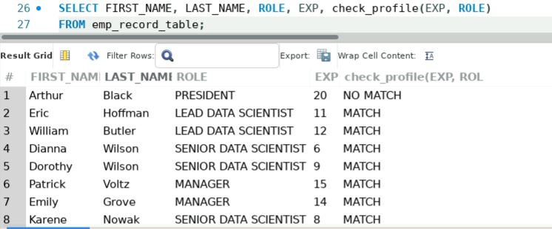
STORED FUNCTION
Task 14: Write a query using stored functions in the project table to check whether the job profile assigned to each employee in the data science team matches the organization’s set standard

Slide 22
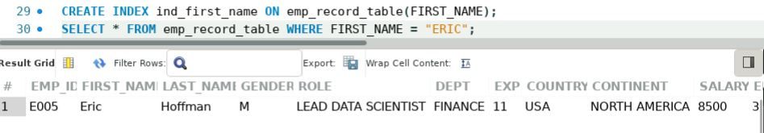
INDEX
Task 15: Create an index to improve the cost and performance of the query to find the employee whose FIRST_NAME is ‘Eric’ in the employee table after checking the execution plan

Slide 23
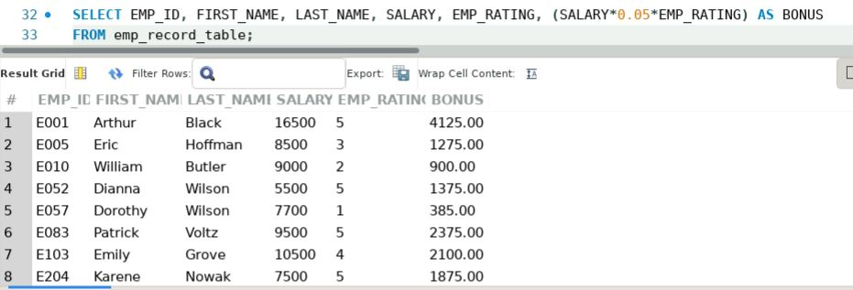
BONUS CALCULATION
Task 16: Write a query to calculate the bonus for all the employees, based on their ratings and salaries (Use the formula: 5% of salary * employee rating)

Slide 24
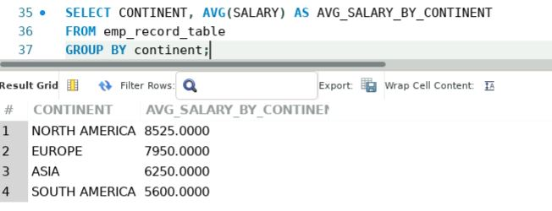
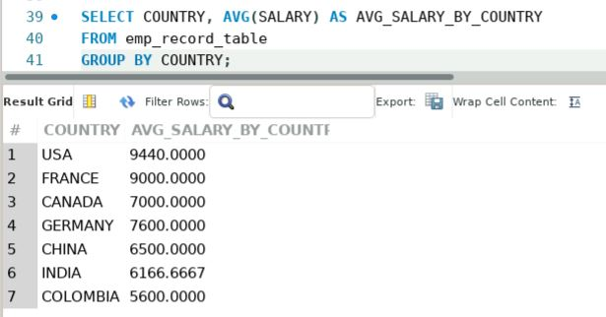
AVG()
Task 17: Write a query to calculate the average salary distribution based on the continent and country. Take data from the employee record table

